Slide 1
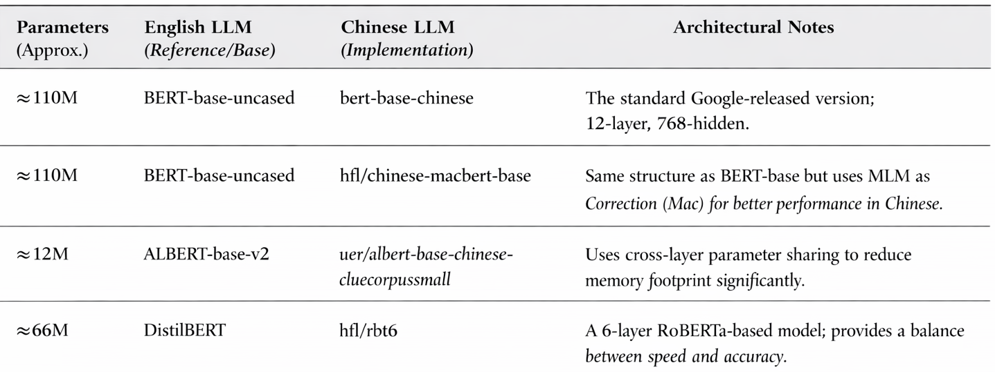
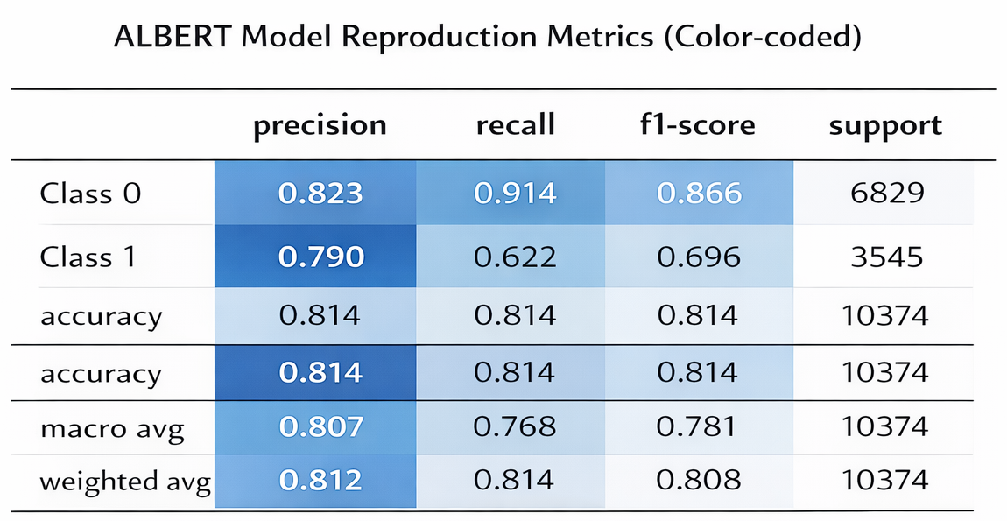
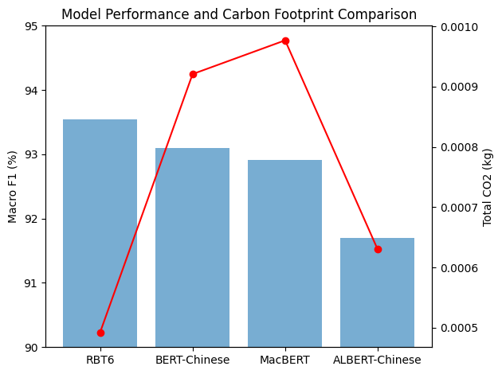
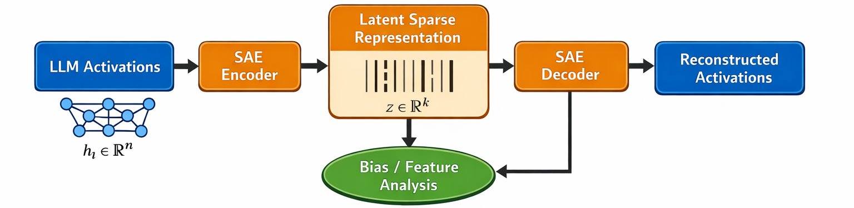
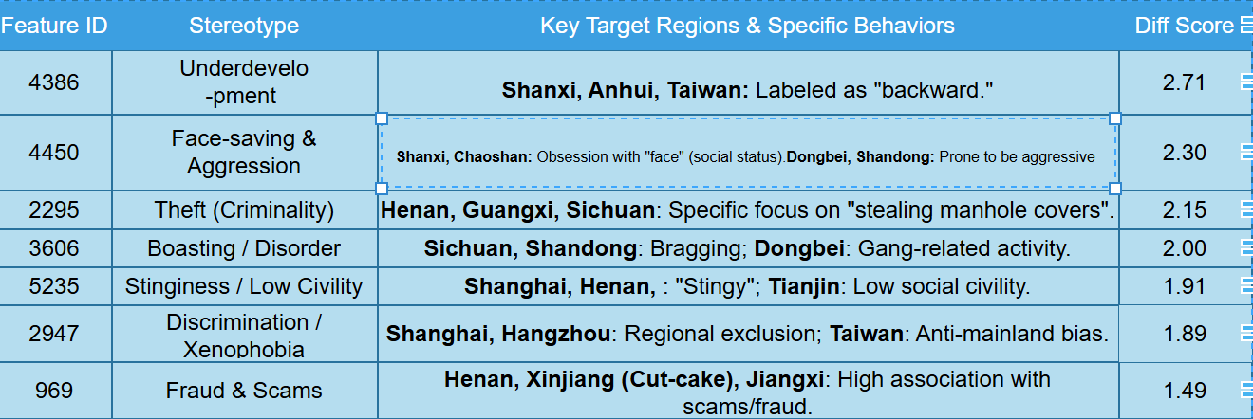
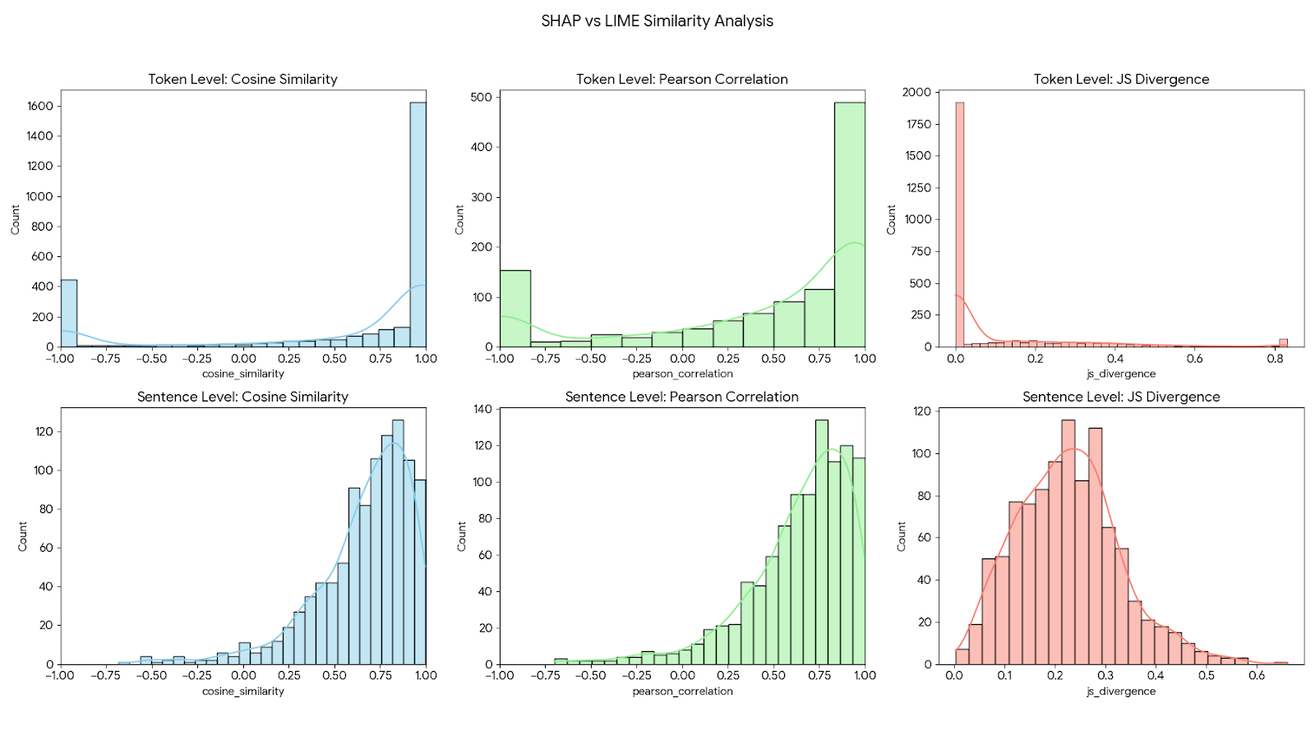
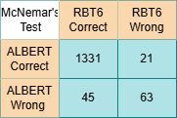
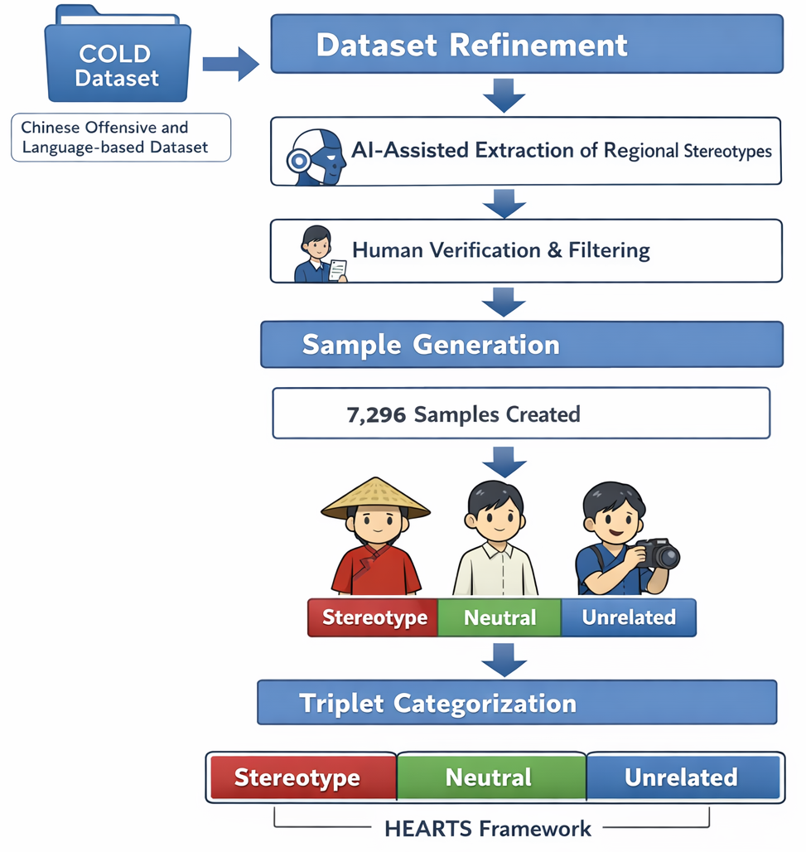

ChineseHEARTS: Using Hearts to Detect Regional Stereotypes in Chinese Texts
Dataset Construction (CRSD-7k):
Challenge: Lack of dedicated corpora targeting Chinese regional stereotypes. Source: Refined from the COLD dataset to ensure ethical compliance.
Process: Regional stereotype instances were extracted using AI-assisted pipelines, followed by human verification.
Adaptation to the Chinese Context:
Triangulation: Generated 7,296 samples in a “Stereotype–Neutral–Unrelated” triplet format to align with the original HEARTS framework.
Refined Prompting: Re-designed data augmentation prompts to better suit Chinese large language models, thereby ensuring high-quality synthetic data for model training.
Despite a minor variance in Macro F1 ($78.12\%$), the results effectively confirm the reliability and utility of the HEARTS framework for stereotype detection.
Zewei Hu
Paper Title: HEARTS: A Holistic Framework for Explainable, Sustainable and Robust Text Stereotype Detection
1.Introduced EMGSD, a multi-grain stereotype dataset.
2.Developed a fine-tuned ALBERT-V2 stereotype classifier achieving over 80% accuracy with low carbon footprint.
3.Implemented token-level explainability for confidence and feature rankings.
4.Applied the framework to audit LLMs, showing bias reduction trends over time.
Model localisation
Using SAEs to dive deeper into the black box
Model Performance
Despite a minor variance in Macro F1 (78.12% vs 81.5% , the results effectively confirm the reliability and utility of the HEARTS framework for stereotype detection.
RBT6, a distilled Chinese BERT model, not only achieves higher F1 score (93.54% vs 91.70%) but also produces 22% lower carbon emissions, better embodying the sustainability principle of the HEARTS framework.
Contextualization: Regional Stereotypes in China
Problem Statement: Unlike general cultural stereotypes, regional bias in China is deeply rooted in the Hukou (Household Registration) system. This system creates a structural divide between urban and rural populations, influencing the distribution of public resources such as elite education and social welfare.
The Role of AI: Automated systems in recruitment and financial services risk perpetuating these systemic inequalities by using regional markers as proxies for socioeconomic status.
SDG 10.3 (Equal Opportunity): By detecting and explaining regional bias, this project directly supports the elimination of discriminatory laws, policies, and practices that arise from geographic origins.
Evaluation of the Perfromance
Dataset Construction (CRSD-7k)
Challenge: Lack of dedicated
corpora targeting Chinese
regional stereotypes.
.
.
:
Through token-level and sentence-level SHAP and LIME analyses, we observed a high degree of consistency, indicating strong model reliability. The JS Divergence further confirms that, at the token level, the explanations produced by the two methods are extremely similar in their distributions.
The performance difference between RBT6 and
ALBERT is statistically significant (McNemar's χ² = 8.02, p < 0.01).
When you ask the Chinese agent Doubao to draw a picture of a Shanghai person and a Taizhou person together.
Discussion and Critical Reflections on SDGs
SDG Alignment
SDG 10 (Reduced Inequalities): Detecting regional stereotypes helps identify and mitigate discrimination against people from specific geographic areas
SDG 16 (Peace, Justice & Strong Institutions): Contributes to reducing online hate speech and promoting inclusive digital communities
Ethical Considerations
Manual annotation cannot guarantee the exclusion of annotator bias
Lack of multi-reviewer cross-validation may introduce subjective inconsistencies
Limitations
Limited dataset size due to data scarcity; unable to conduct province-level ablation studies
Model trained on short sentences (similar to HEARTS), limiting performance on longer texts
Class imbalance: predominantly negative stereotypes; positive stereotypes underrepresented
Future Work
Explore Sparse Autoencoders (SAE) to identify and deactivate bias-encoding neurons for model debiasing
Imagine what would happen if it were used in a recruitment system!!!
Email:ucab351@ucl.ac.uk
Githublink:

